Slide 1
WALL PLACEMENT AND REACHABILITY ANALYSIS
SIMTech
19/05/2025

Slide 2
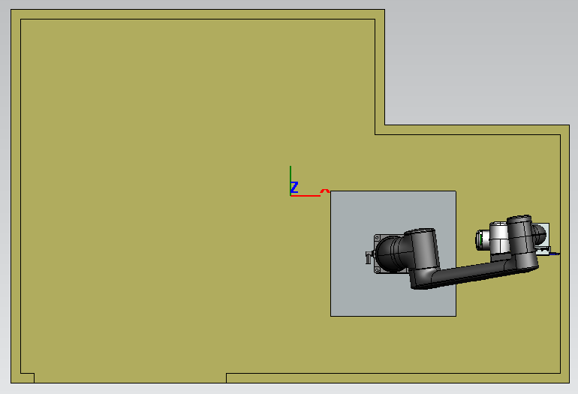
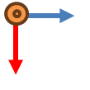

Wall Number Convention
Wall 3
Wall 5
Wall 4
Wall 4
Wall 5
Wall 3
Wall 2
Wall 6
Wall 6
Wall 2
z
y
Door
z
y
Door
Wall 1
Wall 1
x
x

Slide 3
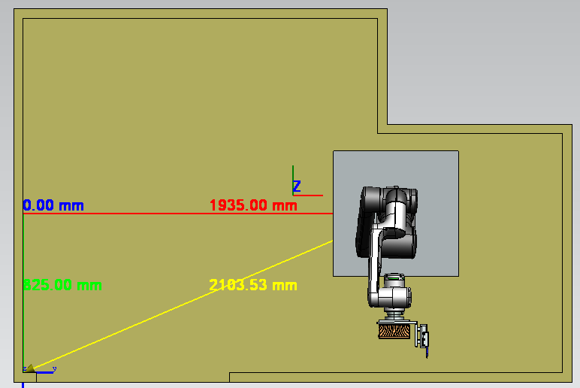
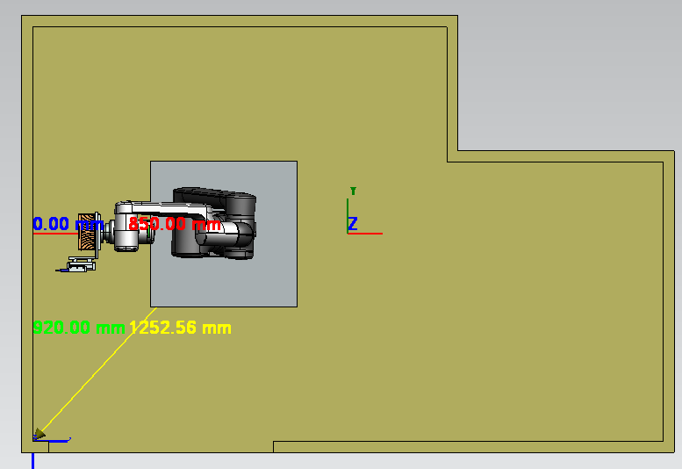
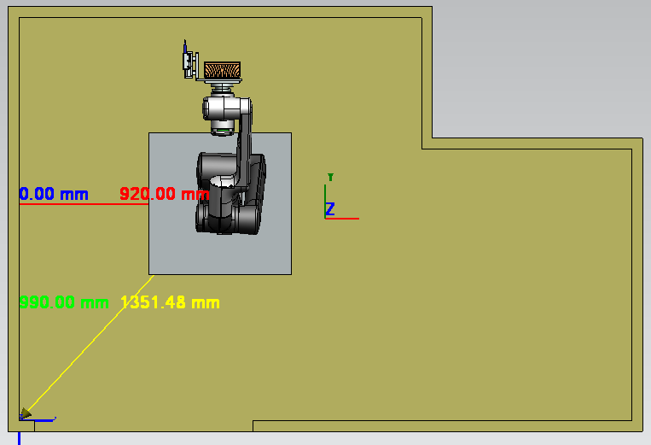
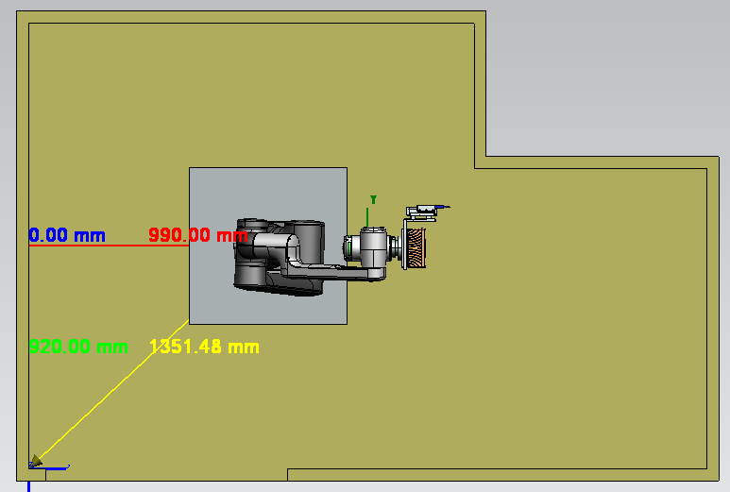
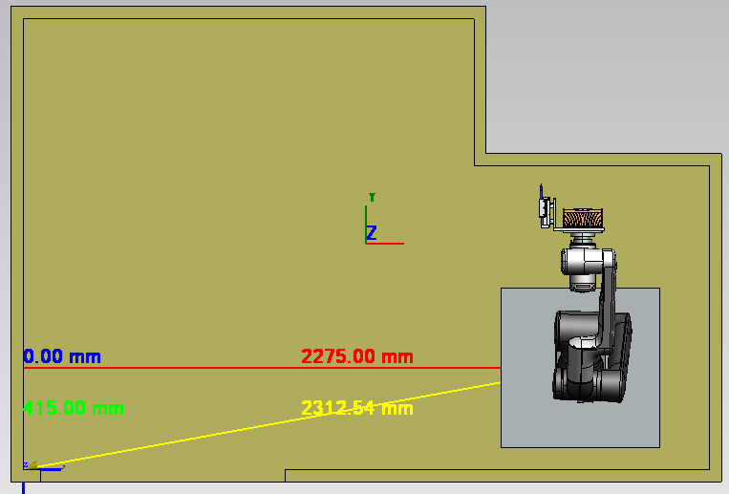
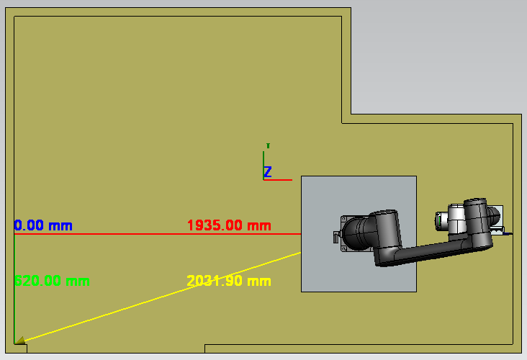
Robot Placement in PBU
Wall 1
Wall 2
Wall 3
Wall 4
Wall 5
Wall 6

Slide 4
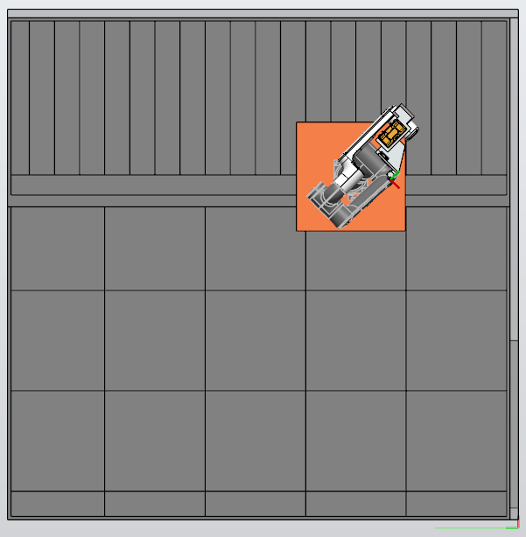
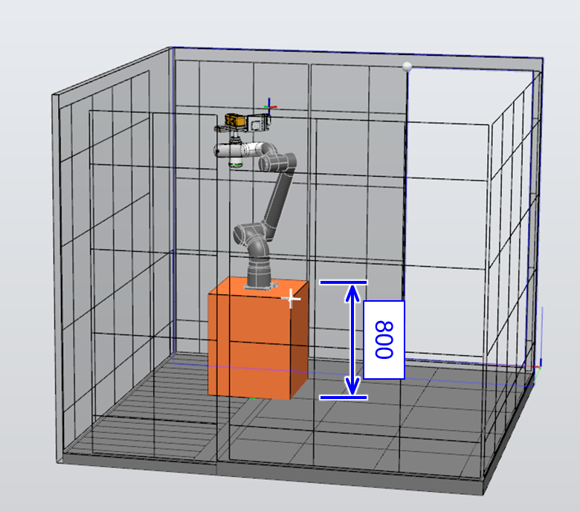
Previous Studies Compared to Current Pose Placement
950
950
650
650
850 mm
Wall 2
3m x 3m PBU Wall Marking Robot Pose Recommendation
Current PBU Robot Pose

Slide 5
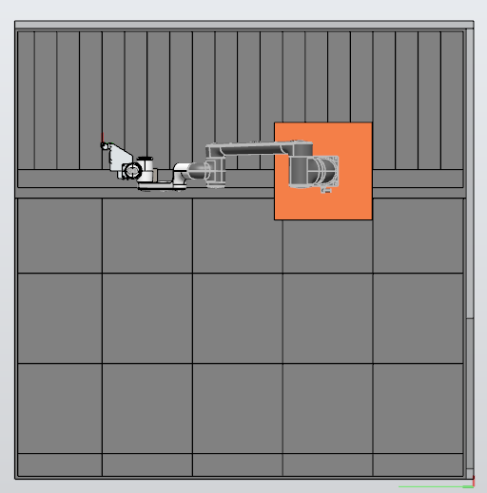
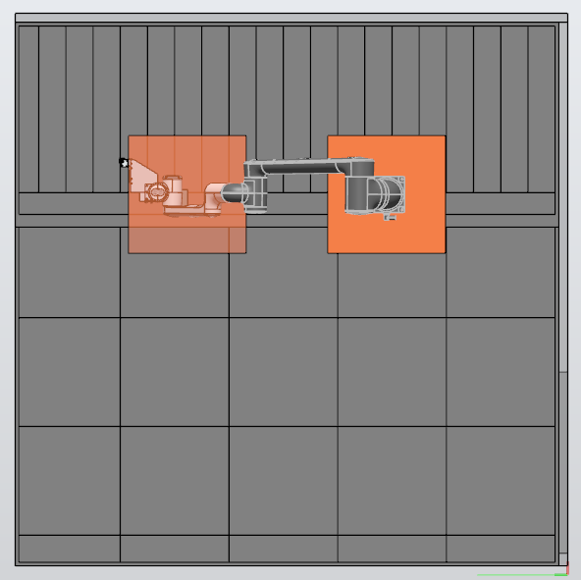
Marking Robot System – Floor Marking Coverage Est.
~DIA2920
Note:
Estimation done in initial stage of project

Slide 6
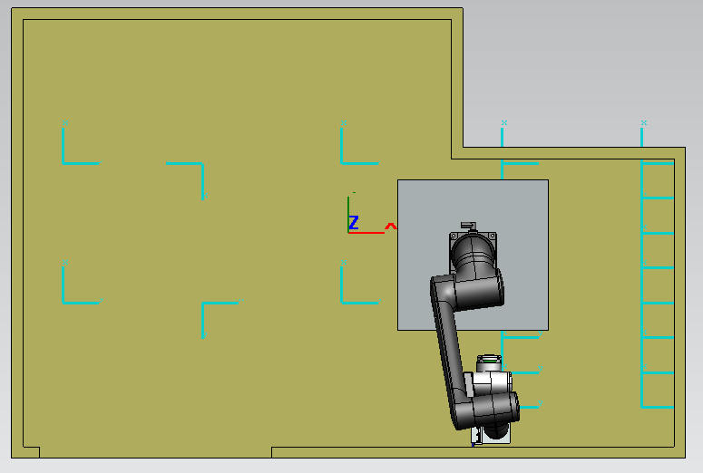
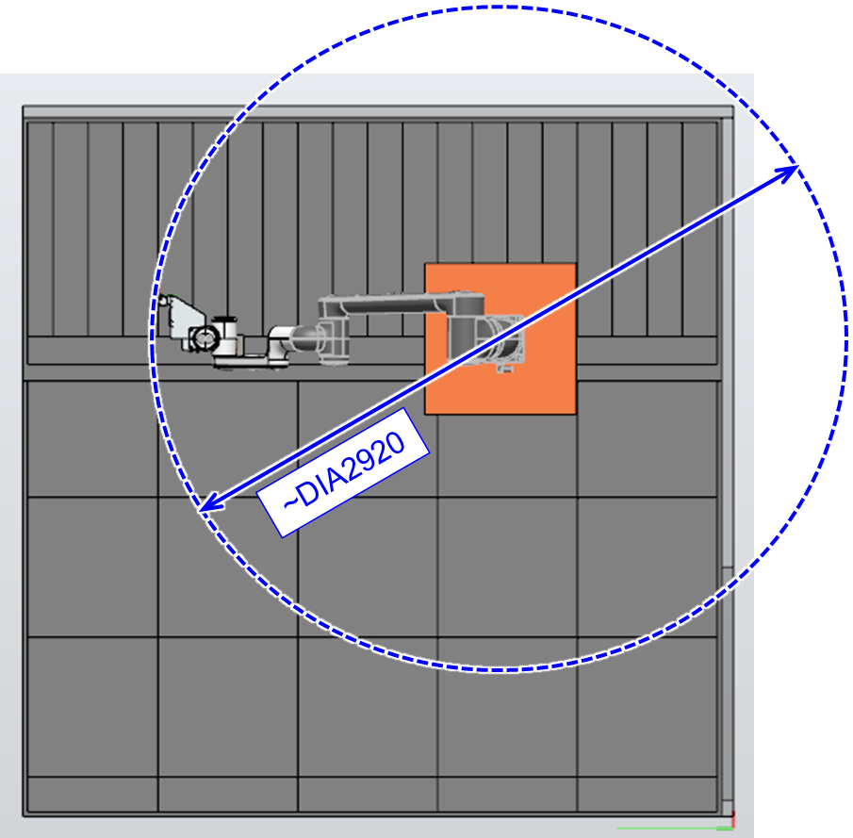
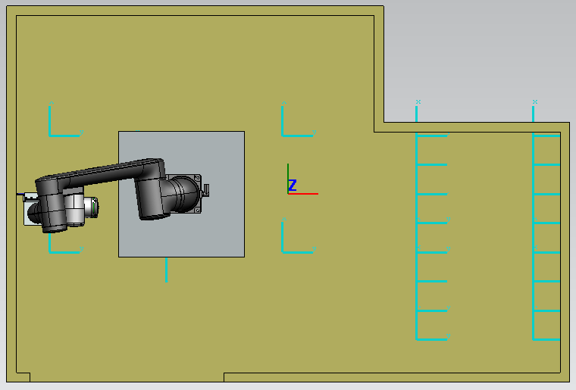
Reachability Analysis of Floor Markings from Robot Positions
 | Wall 1 | Wall 2 | Wall 3 | Wall 4 | Wall 5 | Wall 6
1 | N | Y | Y | Y | N | N
2 | N | Y | Y | Y | N | N
3 | Y | N | N | N | N | N
4 | Y | N | N | N | N | N
5 | Y | Y | Y | Y | Y | Y
6 | Y | Y | Y | Y | N | N
7 | N | Y | Y | Y | Y | Y
8 | N | Y | Y | Y | Y | Y
9 | N | Y | Y | Y | Y | Y
10 | N | Y | Y | Y | Y | Y
11 | N | Y | Y | Y | N | N
12 | N | Y | Y | Y | N | N
13 | Y | N | N | Y | N | N
14 | Y | N | N | Y | N | N
15 | Y | N | N | N | Y | Y
16 | Y | N | N | N | Y | Y
17 | Y | N | N | N | Y | Y
18 | Y | N | N | N | Y | Y
19 | Y | N | N | N | N | N
20 | Y | N | N | N | N | N
21 | Y | N | N | N | N | N
22 | Y | N | N | N | N | N
1840 mm
Floor Coverage Estimation ~ 1460 mm radius
Reachability Table
2800 mm
Note:
2 robot positions to mark all floor tiles

Slide 7
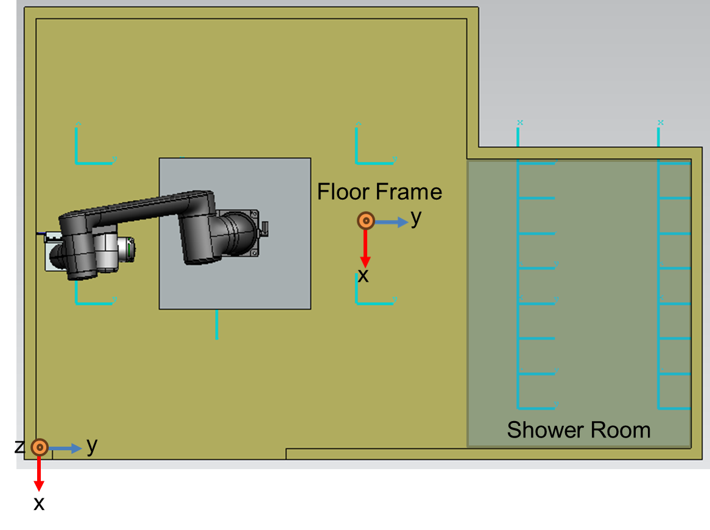
Excel Notes for Floor Marking
Note:
Assuming shower area is 20 mm lower than toilet area
Floor frame height = 1m line height
Floor Frame Placement
 | Marking type | Point number | Position X | Position Y | Position Z | Wall Number | Shape type | Status | Quadrant | Unnamed | Width | Height | Orientation | Diameter
243 | Tile | Toilet 1 | 2.61 | 0.6 | -1 | F | 1 | blank | 1 |  | 2.9 | 1.932
242 | Tile | Toilet 2 | 2.01 | 1.2 | -1 | F | 1 | blank | 1 |  | 2.9 | 1.932
241 | Tile | Toilet 3 | 2.01 | 0.6 | -1 | F | 1 | blank | 1 |  | 2.9 | 1.932
240 | Tile | Toilet 4 | 1.41 | 1.2 | -1 | F | 1 | blank | 1 |  | 2.9 | 1.932
239 | Tile | Toilet 5 | 1.41 | 0.6 | -1 | F | 1 | blank | 1 |  | 2.9 | 1.932
238 | Tile | Toilet 6 | 0.72 | 1.05 | -1 | F | 1 | blank | 1 |  | 2.9 | 1.932
237 | Tile | Shower 1 | 0.72 | 0.9 | -1.02 | F | 1 | blank | 1 |  | 2.9 | 1.932
236 | Tile | Shower 2 | 0.72 | 0.75 | -1.02 | F | 1 | blank | 1 |  | 2.9 | 1.932
235 | Tile | Shower 3 | 0.72 | 0.6 | -1.02 | F | 1 | blank | 1 |  | 2.9 | 1.932
232 | Tile | Shower 4 | 0.72 | 0.15 | -1.02 | F | 1 | blank | 1 |  | 2.9 | 1.932
233 | Tile | Shower 5 | 0.72 | 0.3 | -1.02 | F | 1 | blank | 1 |  | 2.9 | 1.932

